Slide 1


Hand Vasculature Image Analysis and Gender/Age Classifications
Team members: Mona Ahmed Hussein & Amr Mohamed Ashour
Supervisor: Dr. Ahmed Badawi

Slide 2
Content:
Problem Definition
Introduction & literature survey
Material and Methods
Results and Discussion
Conclusion
GUI System
Acknowledgment

Slide 3
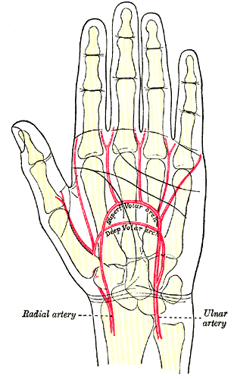
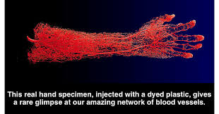
Problem Definition
https://28oa9i1t08037ue3m1l0i861-wpengine.netdna-ssl.com/wp-content/uploads/2014/05/Hand-blood-vessles-FB.png
https://fpnotebook.com/_media/orthoArmHandArteryVolarArchGrayBB1237.gif

Slide 4
Introduction:
What is Biometrics ?

Slide 5
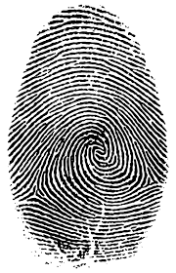
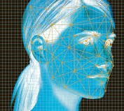
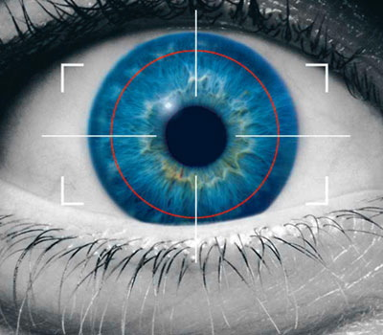
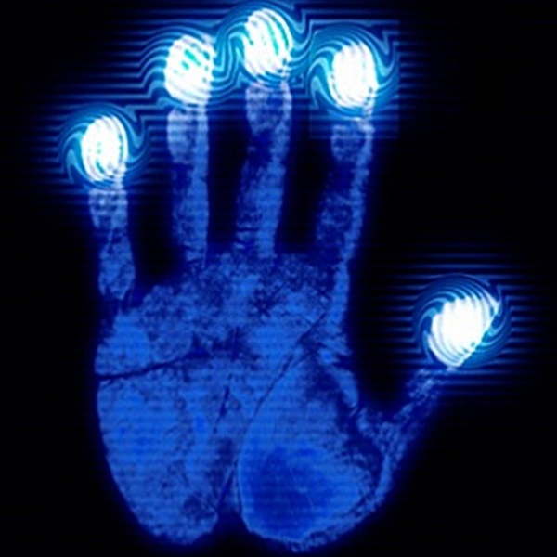
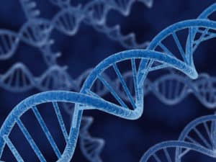
Introduction:
Biometric Characteristics:
Physiological Characteristics:
Fingerprint Face Iris Hand DNA

Slide 6
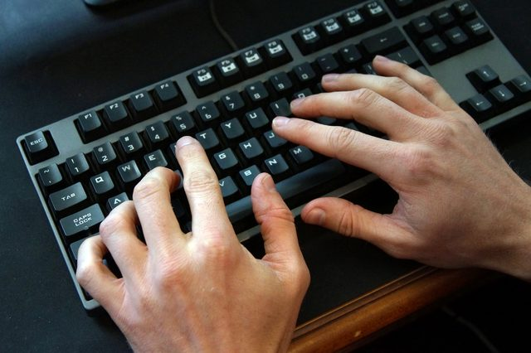
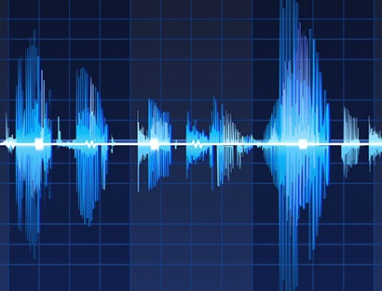
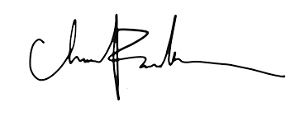
Introduction:
Behavioral Characteristics:
Keystroke Signature Voice

Slide 7
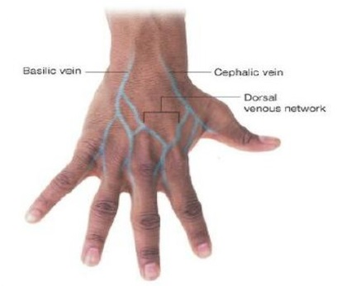
Introduction:
Dorsal View of Hand:

Slide 8
Introduction:
Why Hand Veins ?
Hidden characteristic
Difficult to forge for intruders
Not affected by dryness or roughness of skin
Non-intrusive

Slide 9
Literature Survey:
Previous Studies:
“Peripheral veins: influence of gender, body mass index, age and varicose veins on cross-sectional area” ,2003. K Kröger, et al
"Biometric Authentication Using Fast Correlation of Near Infrared Hand Vein Patterns”, 2008. Ahmed Badawi, et al
"Minutiae feature analysis for infra-red hand vein pattern biometric", 2013.International Journal of Engineering and Technology
"Age and gender classification from finger vein patterns", 2016. Wafa Damak1, et al
“An Analysis of Human Dorsal Hand Skin Texture Using Hyperspectral Imaging Technique for Assessing the Skin Aging Process”, 2016.

Slide 10
Block Diagram of the Project
Data Preparation
Image Pre-Processing
Image Processing
Image Classification
Fusion of Classifiers/
Features
Feature Extraction
Notes:
Features & classifiers

Slide 11
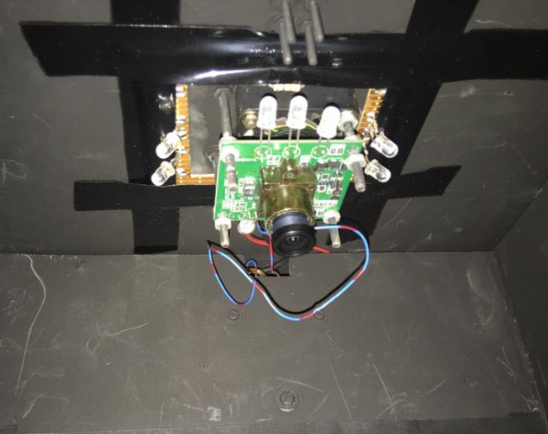
Materials and Methods
Data Preparation:
Near Infrared (NIR) Camera with surrounded by IR LEDs.
Spectral sensitivity characteristics of used silicon based CCD sensor

Slide 12
Dataset & Its Preparation
160 persons/1000 Images
80 Males ,80 Females/500 Images
110 Young ,50 Old/800, 200 Images
5-7 Images for each person
5-7 Images for each person
For left hand

Slide 13
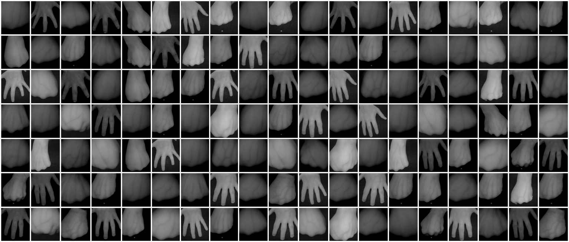
Sample from Data

Slide 14
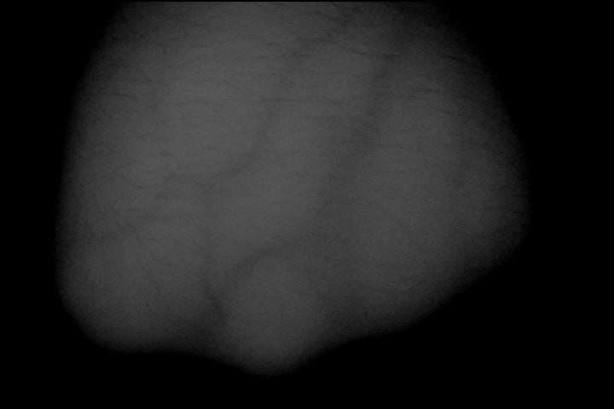
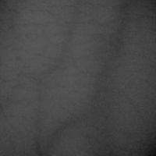
Materials and Methods
Image Preprocessing:
Original Image
ROI Image

Slide 15
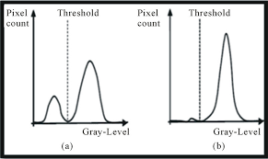
Materials and Methods
Otsu Thresholding
https://encrypted-tbn0.gstatic.com/images?q=tbn:ANd9GcQ-MQPTyzxDzR5qFxQOaxdrvn9YM0QD6anRCOp88bRfUNxOro40

Slide 16



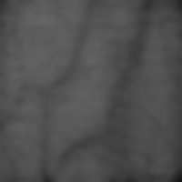
Materials and Methods
Image Processing:
Morphology Filter
Bilateral Filter
Median Filter
CLAHE

Slide 17
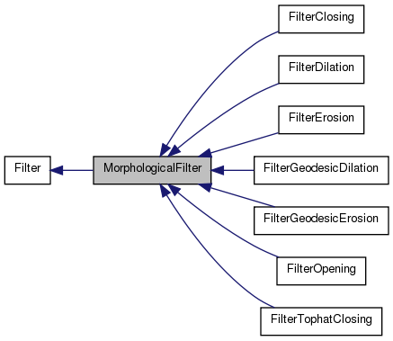
Morphology Filter
https://trac.fawkesrobotics.org/doxygen/classMorphologicalFilter__inherit__graph.png

Slide 18
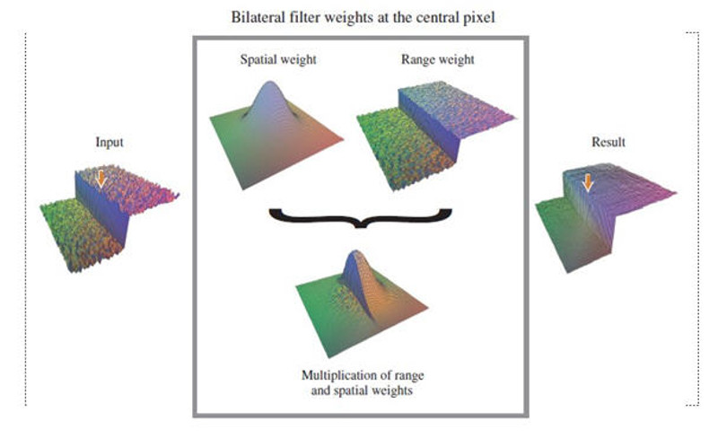
Bilateral Filter
http://www.coldvision.io/wp-content/uploads/2016/01/bilateral_filter.jpg

Slide 19
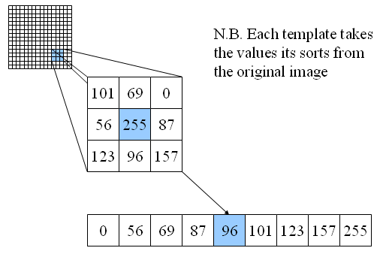
Median Filter
http://users.ecs.soton.ac.uk/msn/book/new_demo/median/

Slide 20
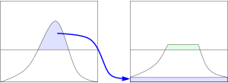
Contrast Limited Adaptive Histogram Equalization (CLAHE)
https://en.wikipedia.org/wiki/Adaptive_histogram_equalization

Slide 21
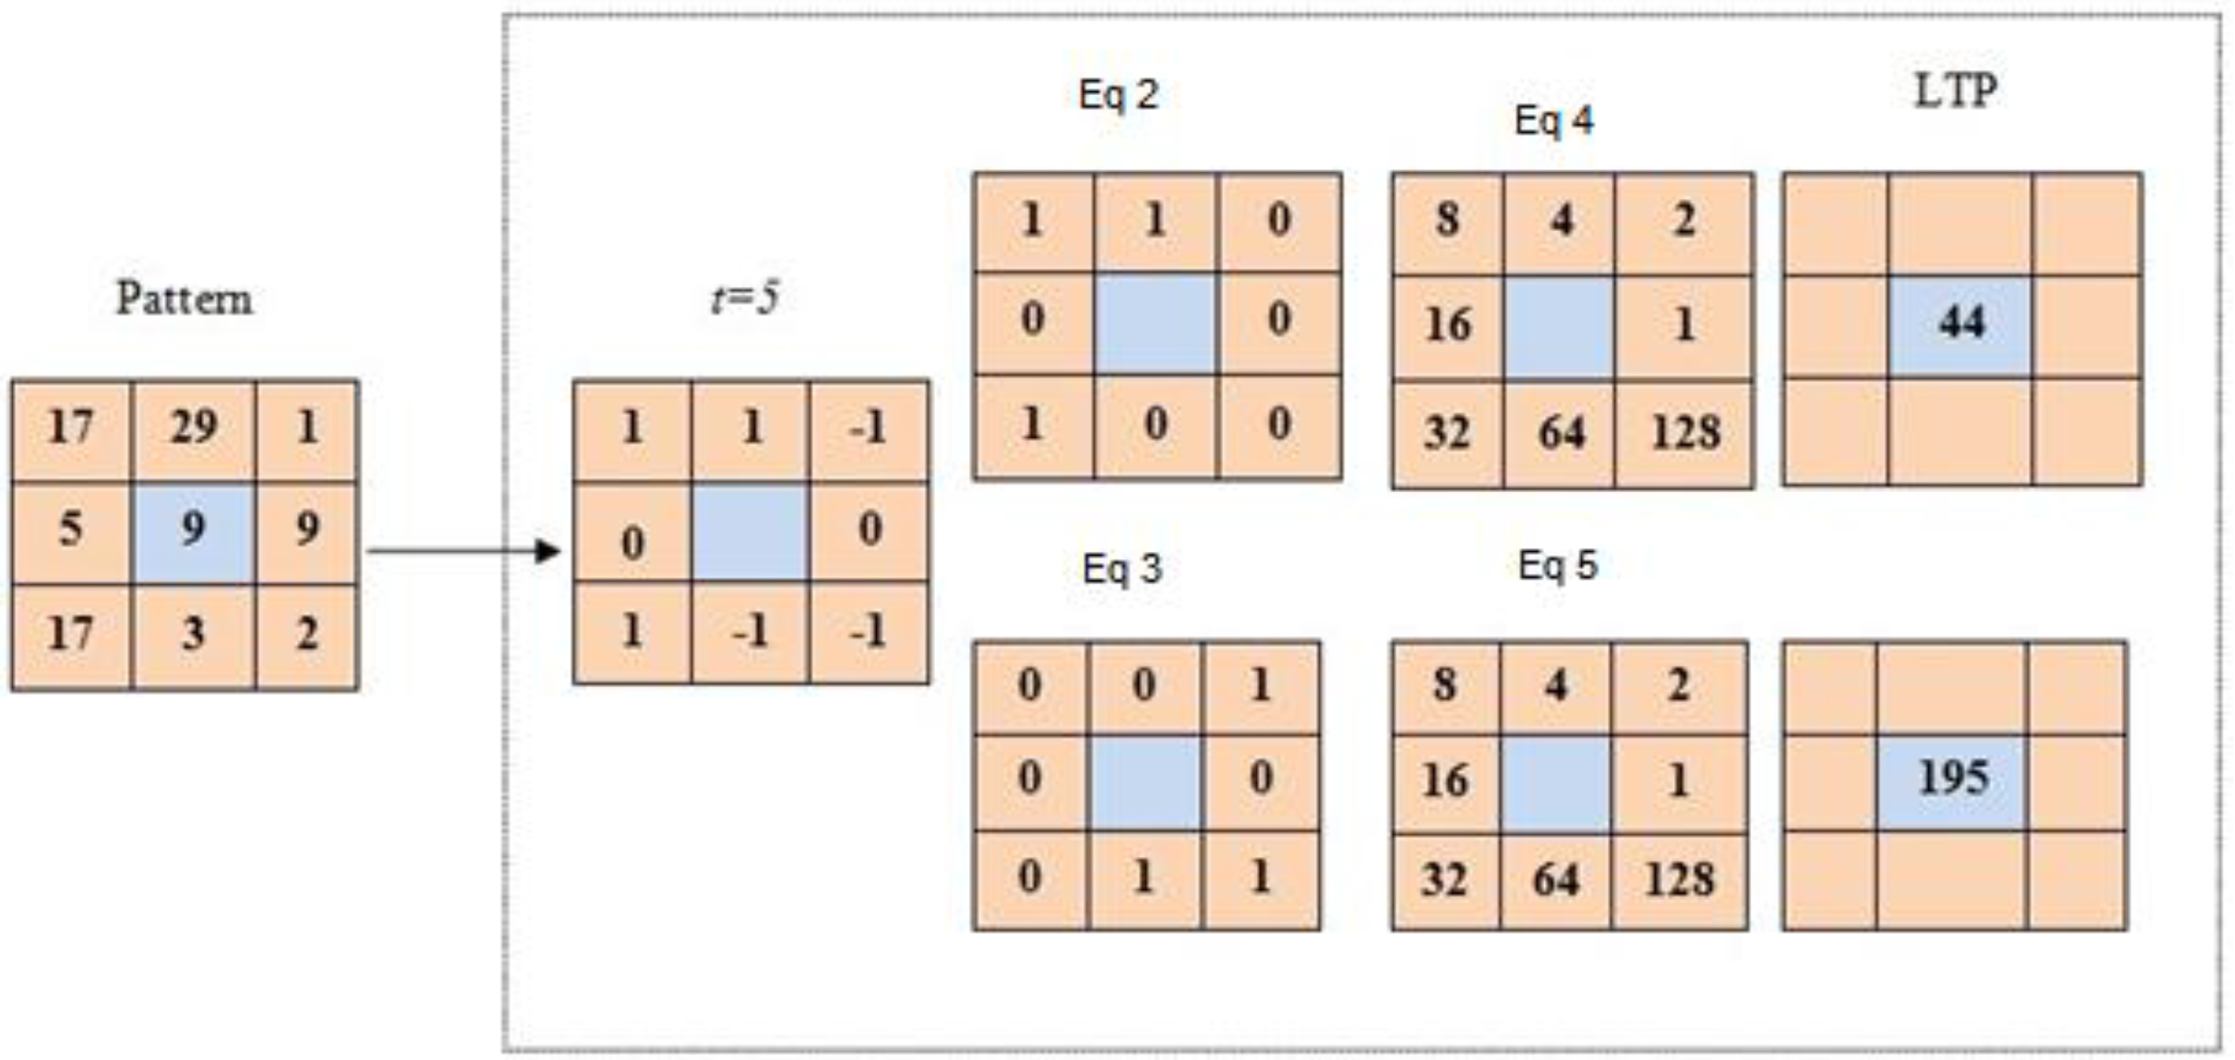
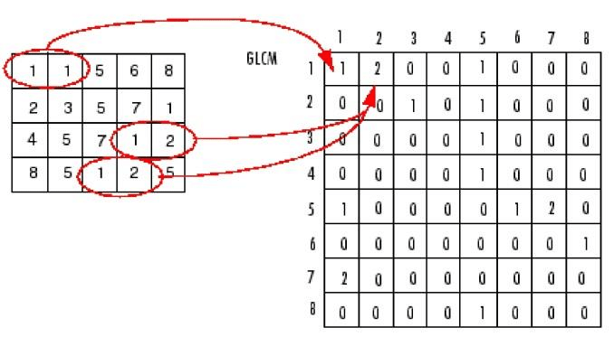
Feature Extraction
Local Binary Pattern (LBP) – Local Ternary Pattern (LTP) – gray level co-occurrence matrix (GLCM)
http://www.mdpi.com/2073-431X/5/2/10
https://www.researchgate.net/figure/Computation-of-Co-occurrence-matrix_fig1_315653921

Slide 22
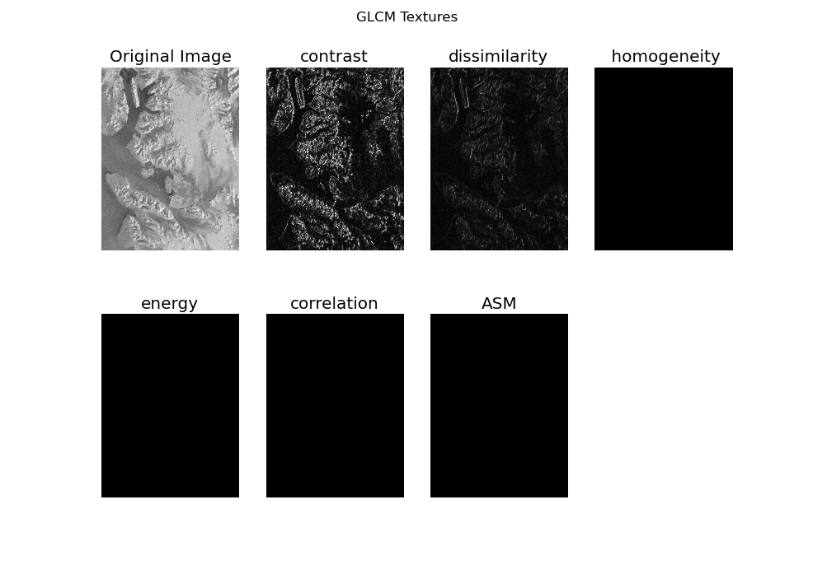
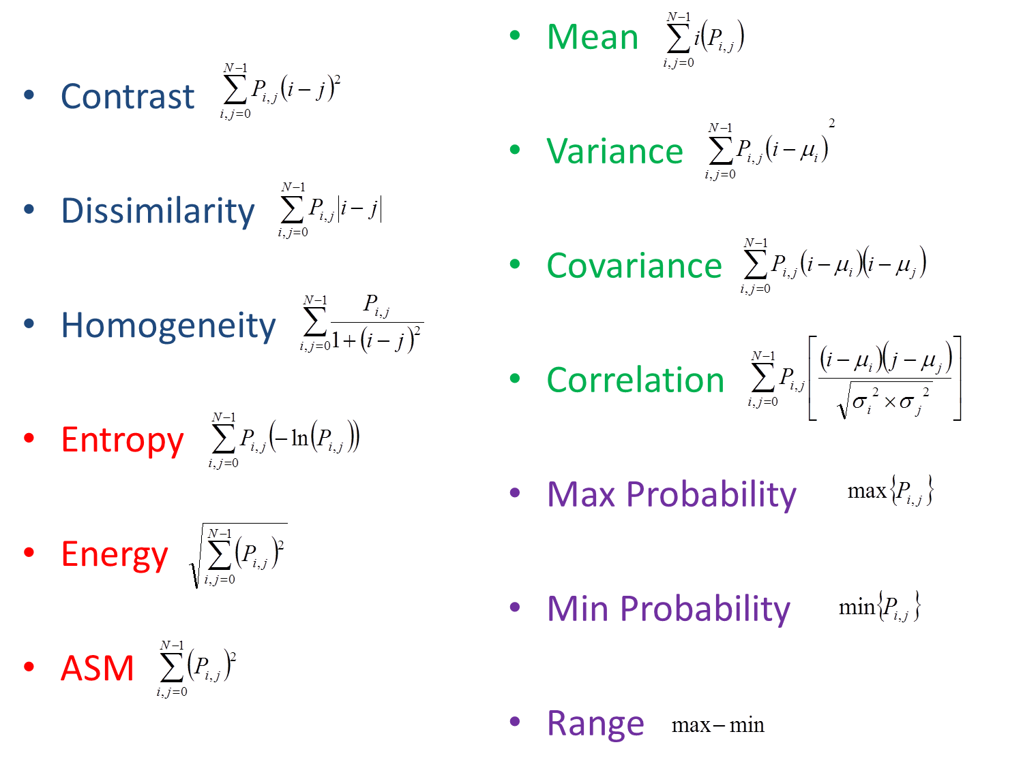
GLCM features
http://geoinformaticstutorial.blogspot.com.eg/2016/02/creating-texture-image-with-glcm-co.html
https://collab.firelab.org/software/projects/rmrsraster/repository/raw/esriUtil/esriUtil/Help/HTML/GLCM.htm

Slide 23
Feature Selection:
LBP Histogram
LTP Histogram
GLCM Features

Slide 24
Age and Gender Classification Methods:
SVM
KNN

Slide 25
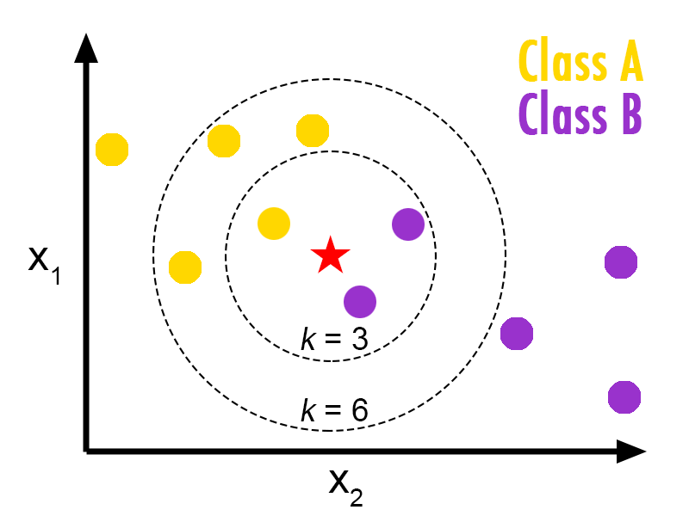
k nearest neighbor (KNN)
https://helloacm.com/a-short-introduction-to-k-nearest-neighbors-algorithm/

Slide 26
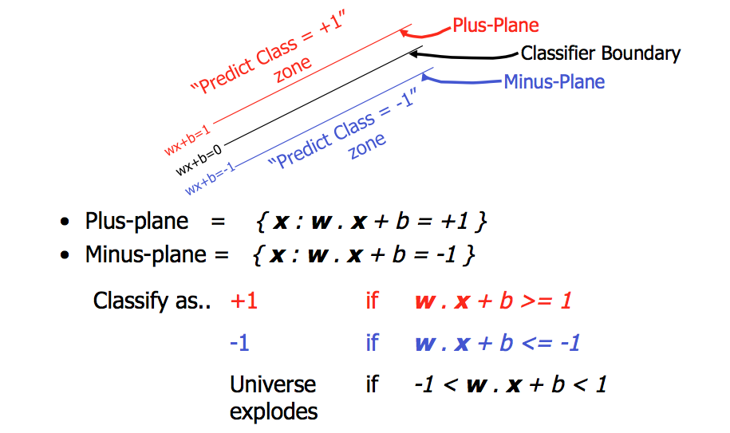
Support vector machine (SVM)
https://stackoverflow.com/questions/21053582/support-vector-machine-geometrical-intuition

Slide 27
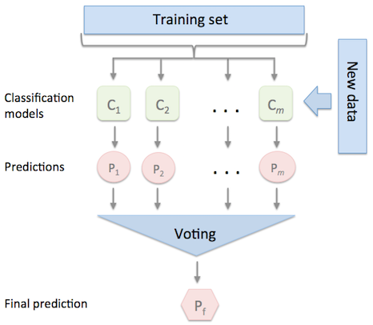
Fusion of Classifiers
https://rasbt.github.io/mlxtend/user_guide/classifier/EnsembleVoteClassifier_files/majority_voting.png

Slide 28
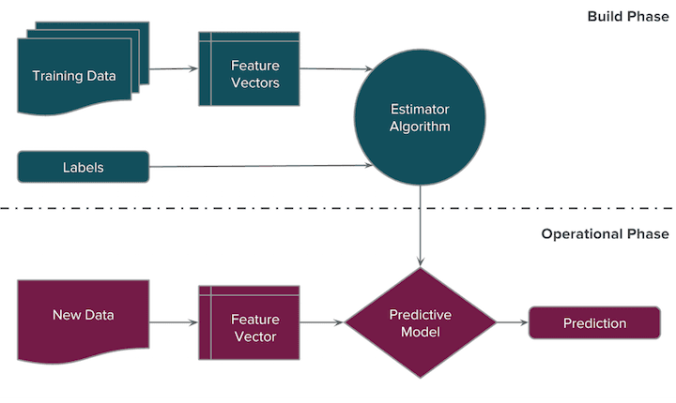
Fusion of Features

Slide 29
Results and Discussion: Gender (Classifiers)
 | Cross Validation/Feature vectors | 1 | 2 | 3 | Best K
Gender Fusion KNN-SVM Data set (50%) | Dissimilarity | 50 | 52 | 56 | 1-5-11
 | Correlation | 51 | 53 | 55 | 11-7-3
 | Contrast | 54 | 54 | 56 | 5-3-9
 | ASM | 57.5 | 61.5 | 63 | 9-13-9
 | LBP | 79 | 83 | 87 | 47-37-35
 | LTP | 63 | 70 | 80 | 5-47-25
Gender Fusion KNN-SVM Data set (70%) | Dissimilarity | 50 | 52 | 56 | 1-5-11
 | Correlation | 51 | 53 | 55 | 11-7-3
 | Contrast | 54 | 54 | 56 | 5-3-9
 | ASM | 79.8 | 72.5 | 87 | 11-13-13
 | LBP | 64.7 | 70 | 72 | 47-37-37
 | LTP | 67.5 | 72.6 | 72 | 9-47-25

Slide 30
Results and Discussion: Age (Classifiers)
 | Cross Validation/Feature vectors | 1 | 2 | 3 | Best K
Age Fusion KNN-SVM Data set (50%) | Dissimilarity | 80 | 80 | 79.8 | 1-5-11
 | Correlation | 80 | 80 | 79.8 | 11-7-3
 | Contrast | 80 | 80 | 79.8 | 5-3-9
 | ASM | 80 | 80 | 79.8 | 11-13-13
 | LBP | 85 | 81 | 82 | 41-45-33
 | LTP | 85 | 82 | 81 | 47-49-49
Age Fusion KNN-SVM Data set (70%) | Dissimilarity | 80 | 80 | 79.8 | 1-5-11
 | Correlation | 80 | 80 | 79.8 | 11-7-3
 | Contrast | 80 | 80 | 79.8 | 5-3-9
 | ASM | 80 | 80 | 79.8 | 11-13-13
 | LBP | 86 | 82 | 81 | 41-45-33
 | LTP | 86 | 81 | 82 | 47-49-49

Slide 31
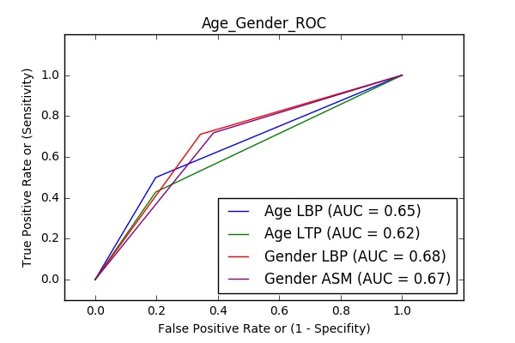
Gender & Age ROC

Slide 32
Results and Discussion: Gender (Features)
 | N times/ Classifiers | 1 | 2 | 3 | Best K
Gender GLCM | KNN | 78.5 | 81.5 | 82 | 3-3-3
 | SVM | 57 | 63 | 65 | ---
Gender LBP/LTP | KNN | 74 | 76 | 79 | 49-49-41
 | SVM | 57 | 62 | 63.5 | ---
Gender GLCM/LBP | KNN | 75 | 77 | 78 | 49-37-49
 | SVM | 56 | 61 | 62 | ---
Gender GLCM/LTP | KNN | 65 | 68 | 69 | 3-45-25
 | SVM | 56 | 61 | 65 | ---
Gender GLCM/LBP/LTP | KNN | 74 | 76 | 79 | 49-37-49
 | SVM | 54 | 60 | 63 | ---

Slide 33
Results and Discussion: Age (Features)
 | N times/ Classifiers | 1 | 2 | 3 | Best K
Age GLCM | KNN | 86 | 85 | 87 | 21-21-21
 | SVM | 80 | 81 | 79.8 | ---
Age LBP/LTP | KNN | 79 | 83 | 84 | 43-49-47
 | SVM | 78 | 79 | 78.5 | ---
Age GLCM/LBP | KNN | 78 | 81 | 82 | 41-49-49
 | SVM | 78.5 | 79.5 | 79 | ---
Age GLCM/LTP | KNN | 76 | 78.5 | 79 | 43-47-49
 | SVM | 79 | 80 | 79.5 | ---
Age GLCM/LBP/LTP | KNN | 80 | 82.5 | 83 | 41-49-49
 | SVM | 79 | 80 | 82 | ---

Slide 34





Our Tools

Slide 35
Conclusion
Data Preparation
Image Pre-Processing
Image Processing
Image Classification
Fusion of Classifiers/
Features
Feature Extraction
Notes:
Features & classifiers

Slide 36
Our Contributions
Applying new filters & algorithms
Enhancing the Accuracy (87% in age and gender)
Designing New GUI System

Slide 37
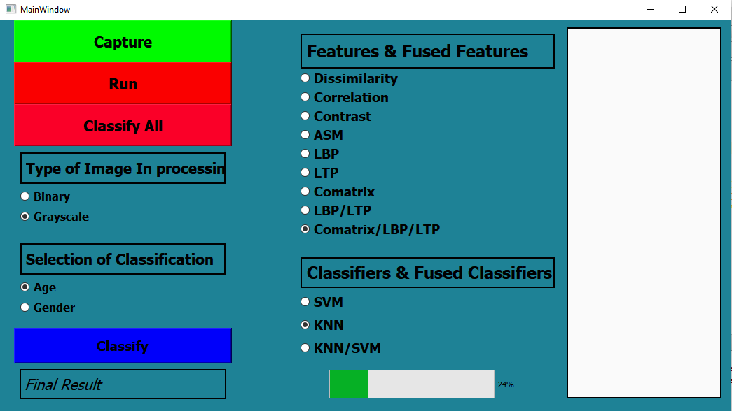
GUI System

Slide 38
Acknowledgment
Special Thanks to:
Dr. Ahmed M Badawi
Eng. Menna Essam
Eng. Marina F. Emil
Eng. Sarah M. Ragab
Eng. Yasmin M. Khattab

Slide 39
Thank You

